Slide 1
Heathkit SB 220 Restoration Project
Heathkit SB-220 Restoration Project
Presented by Charlie - KC6FZY
May 2021 Update

Slide 2
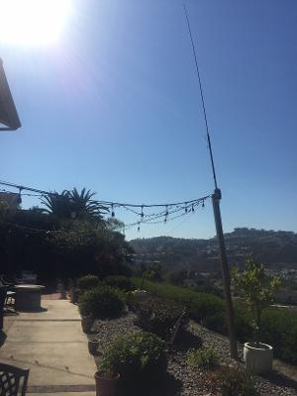
KC6FZY Base Station Setup and Antenna
Bottom Line
Increased Output Power Compensates for Many Station Limitations
SB 220 Linear Amplifier
Power Supply
12 VDC Battery
ICOM 7300
Charlie
NanoVNA for SWR
Measurements
Extra Output Power Compensates for Antenna Inefficiency and Coax Loss
Home-made “Buddy Stick” Center-Fed Vertical Dipole with Counterpoise Tuned for 7,500 KHz

Slide 3
Heathkit SB-220 Linear Amplifier Specifications
Model SB-220
S/N - 14515
Date of Manufacture - Unknown
Modes of Operation – CW, SSB, RTTY, and FM
Power Output 1000 Watts CW and 2000 Watts PEP SSB
Max Input Power – 110 VAC at 20 Amps
Max Exciter Power – 100 Watts
Amplifier Configuration – Grounded Grid
Tubes – Two Eimac 3-500 Zs

Slide 4
Heathkit SB 220 Linear Amplifier Ownership Legacy
Original builder was K3NIE who last used the SB 220 in 1992 and kept it in a box for the next eight years
Offered to WB6GGF in August 2000 who used it for a few years and then put it on the shelf
Passed on to KC6FZY in March 2020 who restored it to operational condition and is currently using it
Amplifier is more than 40 years old!

Slide 5
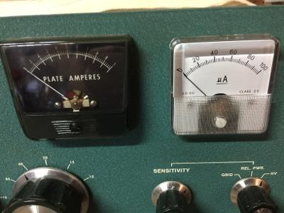
Replacement parts readily available except for Meters
Soft Key- Reduces T/R Control Voltage to 15 VDC
Rectifier Metering Board – Replaced old diode bridge PCB
High Voltage Capacitor Bank –Replaced leaking electrolytic capacitor bank
New Fan –Old fan motor was frozen
Transmit/Receive Relay – Bought new part but didn’t install due to complicated wiring (deferred to future)
Plate Current Meter – Old meter open circuited
Grid Current/Relative Power/High Voltage Meter – Old meter open circuited
Control knobs – Sensitivity and Grid/Rel/HV knobs replaced
Cost for above parts was $372.06
Metering Board
Soft Key
New Meter
Old Meter
https://harbachelectronics.com/product-category/heathkit-sb220-sb221/
Newark an Avnet Company (800-463-9275)
New Knobs

Slide 6
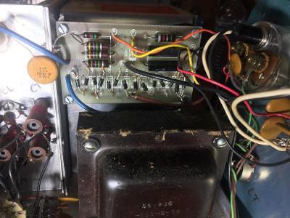
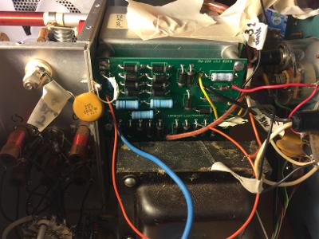
Metering Board and Rectifier Bridge PCB
Under rated full-wave rectifier diode bank
Better diode bank
Before
After

Slide 7
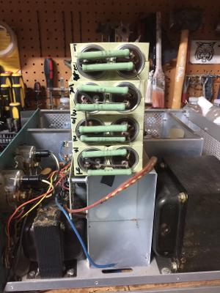
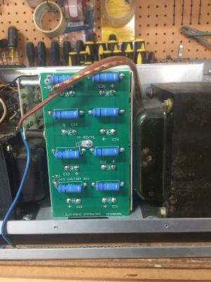
CAPACITORS LEAKING AND EVIDANCEOF ARCING ON BLEEDER RESISTORS
Before
After

Slide 8
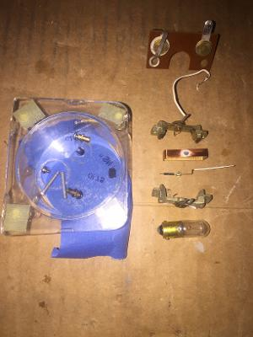
Old Meters Were Corroded and not repairable
To test meter operation short terminals and shake it. If meter movement is dampened then it is probably ok. Otherwise it is broken.
Ohm meters won’t measure meter internal resistance; need to use resistance bridge circuit to solve this limitation.
Old Meter Full-scale Readings were 200 uA @ 0.28 VDC (Replacement Meter Design Equations in Following Chart)

Slide 9
Repacement Meter Design Equations

Slide 10
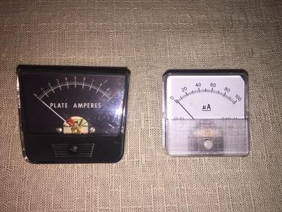
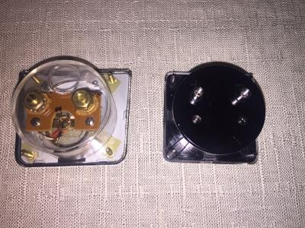
Old and New Panel Meters Had Same Form Factors But Different Electrical Characteristics SB 220 Linear Amplifier Specifications
Before
After
Both Meters About the Same Size
Panel Screw Spacing Identical
Face Up
Face Down

Slide 11
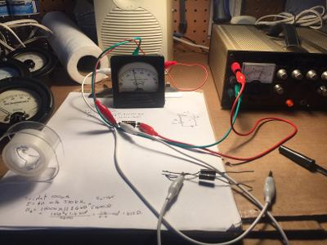
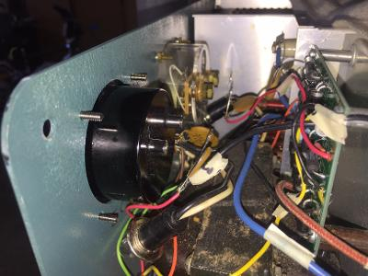
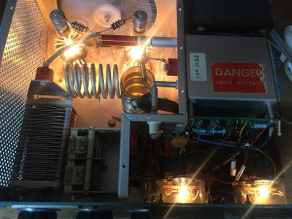
Panel Meter Replacement was Challenging
Determining Old Meter Full Scale Voltage and Resistance
First Measurement of HV (3,000 VDC)
First New Meter Installed)
Tubes Still Worked Worked!

Slide 12
Project Completed Successfully
Meter Microamperes Readings Conversion Factors Taped to Panel Face to Workaround Meter Label Incompatibility (i.e., how to convert uA readings to Amps or Voltage)

